Slide 1
FINANCIAL DERIVATIVES
MODULE -1
DR. KAMALAKKANNAN ADHISEKAR, BE,MBA,NET, PHD
ASSISTANT PROFESSOR

Slide 2
What are Derivatives?
A derivative is a financial instrument whose value is derived from the value of another asset, which is known as the underlying asset.
When the price of the underlying asset changes, the value of the derivative also changes.
A Derivative is not a product. It is a contract that derives its value from changes in the price of the underlying.
Example :
The value of a gold futures contract is derived from the value of the underlying asset i.e. Gold.

Slide 3
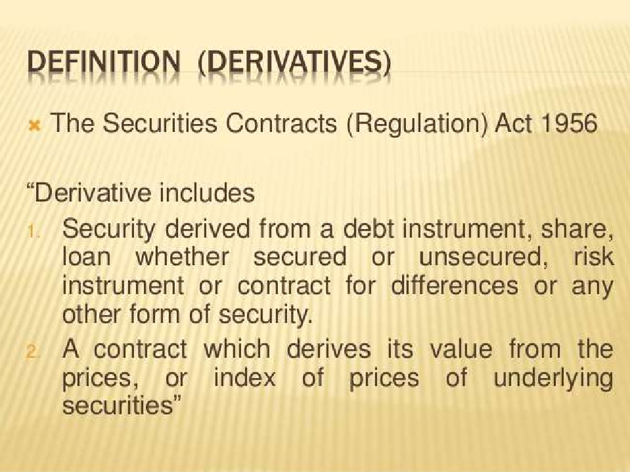

Slide 4
HISTORY OF DERIVATIVES
The word derivatives originated in mathematics and refers to a variable that has been derived from another variable. For example, a measure of distance in KM could be derived from a measure of distance in miles by dividing by 1.61, or Similarly a measure of temperature in Celsius could be derived from a measure of temperature in Fahrenheit. In sense, a derivative is a financial product which had been derived from a market for another product.
Derivative market can be traced back to the middle ages. They were originally developed meet the needs of farmers and merchants.
The Chicago Board of Trade was the first derivatives market established in 1848 to bring farmers and merchants together.
In 1874, the Chicago Produce Exchange was established. In 1919, this was renamed the Chicago Merchantile Exchange (CME) and was reorganized for futures trading. In India it is trading on Multicommodity Exchange (MCX), National Commodity and Derivatives Exchange (NCDEX).

Slide 5
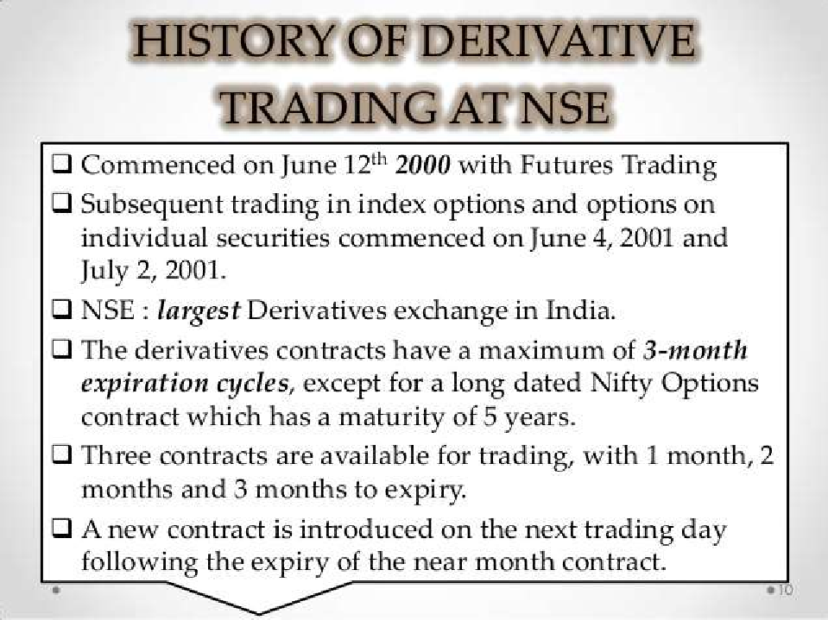

Slide 6
CHARACTERISTICS OF DERIVATIVES
 It has one or more underlying assets
 Requires negligible initial investment compared to other types of financial contracts
 Should provide net settlement I.e., offsetting of initial contract position

Slide 7
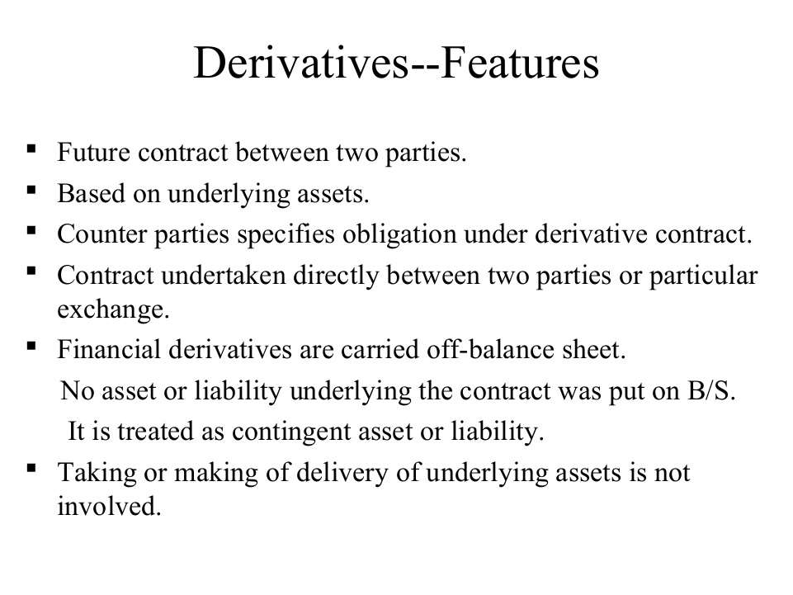

Slide 8
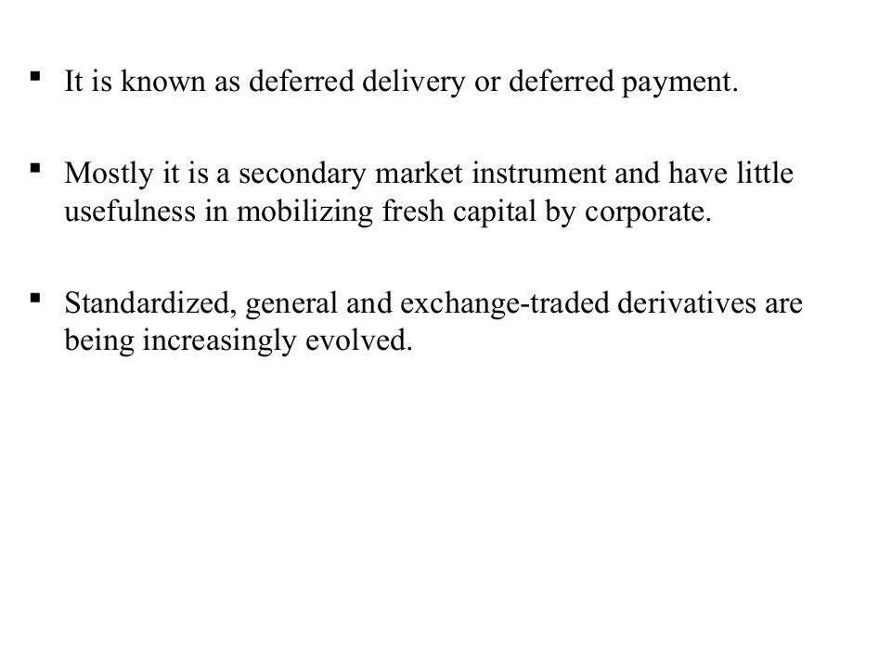

Slide 9
FEATURES OF DERIVATIVES
 The instrument relates to the future contract and settlement of terms between parties involved, normally called maturity period in case of Forward contract.
 The parties involved may be obliged to exercise their contracts or offset them (Forwards, Futures) or may have rights (like option buyers).
 The contracts are fulfilled or transacted through a recognized exchange (Futures contracts) through the clearing house or they may be private bi-lateral contracts (Forwards, Swaps) or OTC contracts (Options)
 The value of derivatives depends on their underlying assets price movements.

Slide 10
FUNCTIONS OF DERIVATIVES MARKET
 Risk management- Stop loss
 Transfer of risk
 Price discovery
 Transitional efficiency - low transaction cost compare to rest like, brokerage, commission, regulatory costs and margin requirements
 Financial Engineering- as it is new field creating calls, puts, futures and other derivatives

Slide 11
USES OF DERIVATIVES
Derivatives are used by companies and individuals wanting to cover their risks. This is facilitated by a counter party who has the motivation to make profits out of the Premium, or is holding a mirror-image opposite position.
Example for derivatives use;
An exporter to the US expects to get $50,000 in 3 months from now. She will be happy to have this converted at around Rs. 45 per $.
However, there is great uncertainty in the foreign exchange market as to the nature of the possible movement after 3 months.
Fortunately for the exporter a bank is willing to enter into a Forwards contract with her for paying Rs. 45 per $ after 3 months on her surrounding $50,000 then.
If the exporter enters into this Forward contract, she makes sure that she will be able to get 22,50,000 ($50,000*Rs.45) after 3 months.
However if the rates change to her favor say to Rs. 48 per $ she will not be able to make advantage of the favorable movement since she is already committed to the Forward Contract/agreement

Slide 12
Economic benefits of derivatives
Reduces risk
Enhance liquidity of the underlying asset
Lower transaction costs
Enhances the price discovery process.
Portfolio Management
Provides signals of market movements
Facilitates financial markets integration

Slide 13
Traders in Derivatives Market
There are 3 types of traders in the Derivatives Market :
HEDGER
A hedger is someone who faces risk associated with price movement of an asset and who uses derivatives as means of reducing risk.
They provide economic balance to the market.
SPECULATOR
A trader who enters the futures market for pursuit of profits, accepting risk in the endeavor.
They provide liquidity and depth to the market.

Slide 14
ARBITRAGEUR
A person who simultaneously enters into transactions in two or more markets to take advantage of the discrepancies between prices in these markets.
Arbitrage involves making profits from relative mispricing.
Arbitrageurs also help to make markets liquid, ensure accurate and uniform pricing, and enhance price stability
They help in bringing about price uniformity and discovery.

Slide 15
OTC and Exchange Traded Derivatives.
1. OTC
Over-the-counter (OTC) or off-exchange trading is to trade financial instruments such as stocks, bonds, commodities or derivatives directly between two parties without going through an exchange or other intermediary.
The contract between the two parties are privately negotiated.
The contract can be tailor-made to the two parties’ liking.
Over-the-counter markets are uncontrolled, unregulated and have very few laws. Its more like a freefall.

Slide 16

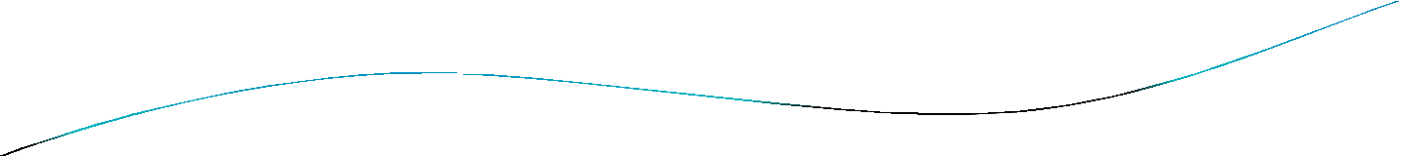


2. Exchange-traded Derivatives
Exchange traded derivatives contract (ETD) are those derivatives instruments that are traded via specialized Derivatives exchange or other exchanges. A derivatives exchange is a market where individuals trade standardized contracts that have been defined by the exchange.
The world's largest derivatives exchanges (by number of transactions) are the Korea Exchange.
There is a very visible and transparent market price for the derivatives.

Slide 17
What is a Forward?
A forward is a contract in which one party commits to buy and the other party commits to sell a specified quantity of an agreed upon asset for a pre-determined price at a specific date in the future.
It is a customised contract, in the sense that the terms of the contract are agreed upon by the individual parties.
Hence, it is traded OTC.

Slide 18



Forward Contract Example
I agree to sell 500kgs wheat at Rs.40/kg after 3 months.
Farmer
Bread Maker
3 months Later
500kgs wheat
Bread Maker
Farmer
Rs.20,000

Slide 19

Risks in Forward Contracts
Credit Risk – Does the other party have the means to pay?
Operational Risk – Will the other party make delivery? Will the other party accept delivery?
Liquidity Risk – Incase either party wants to opt out of the contract, how to find another counter party?

Slide 20

Terminology
Long position - Buyer
Short position - seller
Spot price – Price of the asset in the spot market.(market price)
Delivery/forward price – Price of the asset at the delivery date.

Slide 21

What are Futures?
A future is a standardised forward contract.
It is traded on an organised exchange.
Standardisations-
  quantity of underlying
  quality of underlying(not required in financial futures)
  delivery dates and procedure
  price quotes

Slide 22










A
Futures Contract Example
Market Price/Spot Price
L $10
S $12
Profit $2
D1 | $10
D2 | $12
D3 | $14
B
S $10
C
L $12
L $14
S $14
Loss $4
Profit $2

Slide 23
Types of Futures Contracts
Stock Futures Trading (dealing with shares)
Commodity Futures Trading (dealing with gold futures, crude oil futures)
Index Futures Trading (dealing with stock market indices)

Slide 24
Closing a Futures Position
Most futures contracts are not held till expiry, but closed before that.
If held till expiry, they are generally settled by delivery. (2- 3%)
By closing a futures contract before expiry, the net difference is settled between traders, without physical delivery of the underlying.

Slide 25
Terminology
Contract size – The amount of the asset that has to be delivered under one contract. All futures are sold in multiples of lots which is decided by the exchange board.
Eg. If the lot size of Tata steel is 500 shares, then one futures contract is necessarily 500 shares.
Contract cycle – The period for which a contract trades. The futures on the NSE have one (near) month, two (next)
months, three (far) months expiry cycles.
Expiry date – usually last Thursday of every month or previous day if Thursday is public holiday.

Slide 26

Terminology
Strike price – The agreed price of the deal is called the strike price.
Cost of carry – Difference between strike price and current price.

Slide 27
Margins
A margin is an amount of a money that must be deposited with the clearing house by both buyers and sellers in a margin account in order to open a futures contract.
It ensures performance of the terms of the contract.
Its aim is to minimise the risk of default by either counterparty.

Slide 28

Margins
Initial Margin - Deposit that a trader must make before trading any futures. Usually, 10% of the contract size.
Maintenance Margin - When margin reaches a minimum maintenance level, the trader is required to bring the margin back to its initial level. The maintenance margin is generally about 75% of the initial margin.
Variation Margin - Additional margin required to bring an account up to the required level.
Margin call – If amt in the margin A/C falls below the maintenance level, a margin call is made to fill the gap.

Slide 29
Marking to Market
This is the practice of periodically adjusting the margin account by adding or subtracting funds based on changes in market value to reflect the investor’s gain or loss.
This leads to changes in margin amounts daily.
This ensures that there are o defaults by the parties.

Slide 30

COMPARISON | FORWARD | FUTURES
Trade on organized exchanges | No | Yes
Use standardized contract terms | No | Yes
Use associate clearinghouses to guarantee contract fulfillment | No | Yes
Require margin payments and daily
settlements | No | Yes
Markets are transparent | No | Yes
Marked to market daily | No | Yes
Closed prior to delivery | No | Mostly
Profits or losses realised daily | No | Yes

Slide 31

What are Options?
Contracts that give the holder the option to buy/sell specified quantity of the underlying assets at a particular price on or before a specified time period.
The word “option” means that the holder has the right but not the obligation to buy/sell underlying assets.

Slide 32
Types of Options
Options are of two types – call and put.
Call option give the buyer the right but not the obligation to buy a given quantity of the underlying asset, at a given price on or before a particular date by paying a premium.
Puts give the buyer the right, but not obligation to sell a given quantity of the underlying asset at a given price on or before a particular date by paying a premium.

Slide 33

Types of Options (cont.)
The other two types are – European style options and American style options.
European style options can be exercised only on the maturity date of the option, also known as the expiry date.
American style options can be exercised at any time before and on the expiry date.

Slide 34




Call Option Example
CALL OPTION
Current Price = Rs.250
Premium = Rs.25/share
Right to buy 100 Reliance shares at a price of Rs.300
Strike Price
Amt to buy Call option = Rs.2500
per share after 3 months.
Expiry
date
Suppose after a month, Market price is Rs.400, then the option is exercised i.e. the shares are bought.
Net gain = 40,000-30,000- 2500 = Rs.7500
Suppose after a month, market price is Rs.200, then the option is not exercised.
Net Loss = Premium amt
= Rs.2500

Slide 35


Put Option Example
PUT OPTION
Current Price = Rs.250
Premium = Rs.25/share
Right to sell 100 Reliance shares at a price of Rs.300
Strike Price
Amt to buy Call option = Rs.2500
per share after 3 months.
Expiry
date
Suppose after a month, Market price is Rs.200, then the option is exercised i.e. the shares are sold.
Net gain = 30,000-20,000- 2500 = Rs.7500
Suppose after a month, market price is Rs.300, then the option is not exercised.
Net Loss = Premium amt
= Rs.2500

Slide 36

Features of Options
A fixed maturity date on which they expire. (Expiry date)
The price at which the option is exercised is called the exercise price or strike price.
The person who writes the option and is the seller is referred as the “option writer”, and who holds the option and is the buyer is called “option holder”.
The premium is the price paid for the option by the buyer to the seller.
A clearing house is interposed between the writer and the
buyer which guarantees performance of the contract.

Slide 37
Options Terminology
Underlying: Specific security or asset.
Option premium: Price paid.
Strike price: Pre-decided price.
Expiration date: Date on which option expires.
Exercise date: Option is exercised.
Open interest: Total numbers of option contracts that have not yet been expired.
Option holder: One who buys option.
Option writer: One who sells option.

Slide 38
Options Terminology (cont.)
Option class: All listed options of a type on a particular instrument.
Option series: A series that consists of all the options of a given class with the same expiry date and strike price.
Put-call ratio: The ratio of puts to the calls traded in the market.

Slide 39

Options Terminology (cont.)
Moneyness: Concept that refers to the potential profit or loss from the exercise of the option. An option maybe in the money, out of the money, or at the money.
In the money | Call Option | Put Option
 | Spot price > strike price | Spot price < strike price
At the money | Spot price = strike price | Spot price = strike price
Out of the money | Spot price < strike price | Spot price > strike price

Slide 40
What are SWAPS?
In a swap, two counter parties agree to enter into a contractual agreement wherein they agree to exchange cash flows at periodic intervals.
Most swaps are traded “Over The Counter”.
Some are also traded on futures exchange market.

Slide 41
Types of Swaps
There are 2 main types of swaps:
Plain vanilla fixed for floating swaps or simply interest rate swaps.
Fixed for fixed currency swaps or simply currency swaps.

Slide 42
What is an Interest Rate Swap?
A company agrees to pay a pre-determined fixed interest rate on a notional principal for a fixed number of years.
In return, it receives interest at a floating rate on the same notional principal for the same period of time.
The principal is not exchanged. Hence, it is called a notional amount.

Slide 43
Floating Interest Rate
LIBOR – London Interbank Offered Rate
It is the average interest rate estimated by leading banks in London.
It is the primary benchmark for short term interest rates around the world.
Similarly, we have MIBOR i.e. Mumbai Interbank Offered Rate.
It is calculated by the NSE as a weighted average of lending rates of a group of banks.

Slide 44





Interest Rate Swap Example
LIBOR
SWAPS BANK
LIBOR
Co.A
Co.B
8%
8.5%
Aim - FIXED
Aim - VARIABLE
5m
7%
5m
LIBOR
+ 1%
Notional Amount =
£ 5 million
Bank A
Bank B
Fixed Variable
7% LIBOR
Fixed 10%
Variable LIBOR + 1%

Slide 45
Using a Swap to Transform a Liability
Firm A has transformed a fixed rate liability into a floater.
  A is borrowing at LIBOR – 1%
  A savings of 1%
Firm B has transformed a floating rate liability into a fixed rate liability.
  B is borrowing at 9.5%
  A savings of 0.5%.
Swaps Bank Profits = 8.5%-8% = 0.5%

Slide 46
What is a Currency Swap?
It is a swap that includes exchange of principal and interest rates in one currency for the same in another currency.
It is considered to be a foreign exchange transaction.
It is not required by law to be shown in the balance sheets.
The principal may be exchanged either at the beginning or at the end of the tenure.

Slide 47
However, if it is exchanged at the end of the life of the swap, the principal value may be very different.
It is generally used to hedge against exchange rate fluctuations.

Slide 48
Direct Currency Swap Example
Firm A is an American company and wants to borrow
€40,000 for 3 years.
Firm B is a French company and wants to borrow $60,000 for 3 years.
Suppose the current exchange rate is €1 = $1.50.

Slide 49
Direct Currency Swap Example
7%
Firm B
Firm A
5%
Aim - DOLLAR
Aim - EURO
7%
5%
$60th
€40th
Bank A
Bank B
€
$
6%
7%
€
$
5%
8%

Slide 50
Comparative Advantage
Firm A has a comparative advantage in borrowing Dollars.
Firm B has a comparative advantage in borrowing Euros.
This comparative advantage helps in reducing borrowing cost and hedging against exchange rate fluctuations.

